Slide 1

SREENIVASA INSTITUTE OF TECHNOLOGY AND MANAGEMENT STUDIES
(Approved by AICTE & Affiliated to JNTUA, Ananthapuramu)
Chittoor, A.P-517127.
DEPARTMENT OF COMPUTER SCIENCE AND ENGINEERING
(2025-26)
AN INTERNSHIP PROJECT REVIEW
on
ARTIFICIAL INTELLIGENCE
by
M HEMESH | 22751A0584
Under the guidance of
Mr. Pandreti Praveen MCA., M. Tech.,
Assistant Professor,
Department of Computer Science And Engineering,
Sreenivasa Institute of Technology and Management Studies, Chittoor, A.P.
Artificial Intelligence 03/11/2025

Slide 2
Content
Internship details
Company details
Introduction to domain
List of task’s
Task
Conclusion
Artificial Intelligence 03/11/2025

Slide 3
Internship Details
Title : Artificial Intelligence
Company : SkillDzire
Duration : 4 Weeks
Topics Covered : Machine Learning , Natural Language Processing , Image Classification , Sentiment Analysis
Artificial Intelligence 03/11/2025

Slide 4
Company Details
SkillDzire is an organization where students get trained by industry experts along with certification & placements.
Website : https://skilldzire.com
Industry : IT Services and Training
Address : Hyderabad , India
Artificial Intelligence 03/11/2025

Slide 5
Introduction to domain
Artificial Intelligence (AI) is the branch of computer science focused on building systems capable of performing tasks that normally require human intelligence, such as learning, reasoning, problem-solving, and understanding natural language.
AI domain is a multidisciplinary field merging computer science, mathematics, neuroscience, linguistics, and engineering.
With rapid advancements, AI increasingly transforms industries and daily life.
Artificial Intelligence 03/11/2025

Slide 6
Algorithms : Rule based scoring, CNN, Naive Bayes.
Models : Lexicon Model, CNN Model, Naive Bayes Model.
Modules : nltk.sentiment, nltk.tokenize, cv2, tensorflow.keras.models, tensorflow.keras.layers, sklearn.naive_bayes, sklearn.model_selection, sklearn.metrics.
Artificial Intelligence 03/11/2025

Slide 7
List of tasks
Task 1 : Chat analyzer and emotion detector
Task 2 : Development of an image classification model for a custom dataset
Task 3 : Spam email classifier
Artificial Intelligence 03/11/2025

Slide 8
TASK 1
Chat Analyzer and Emotion Detector
Artificial Intelligence 03/11/2025

Slide 9
Abstract
Digital communication platforms such as WhatsApp, Messenger, and Telegram generate massive amounts of chat data daily.
These conversations not only reflect communication patterns but also carry emotional and psychological signals.
A Chat Analyzer and Emotion Detector aims to process chat transcripts to extract meaningful insights such as user activity, word usage, conversation trends, and emotional states.
By leveraging Artificial Intelligence (AI), Machine Learning (ML), and Natural Language Processing (NLP), the system can detect sentiments (positive, negative, neutral) and classify emotions (joy, sadness, anger, fear, surprise, etc.).
This project is useful for personal reflection, group behavior analysis, business analytics, and research in psychology/social sciences.
Artificial Intelligence 03/11/2025

Slide 10
Existing System
Rule based sentiment scoring (keyword and polarity counts).
Sentiment is identified based on keywords and their polarity (positive / negative / neutral).
Artificial Intelligence 03/11/2025

Slide 11
Disadvantages
Misclassification (sarcasm, mixed emotions) causing false positives/negatives.
Lower Accuracy.
Higher cost and possible latency.
Needs labeled data, retraining, and human review for critical cases.
Artificial Intelligence 03/11/2025

Slide 12
Proposed System
Emotion recognition using lexicon-based methods (VADER, NRC).
Preprocessing that normalizes text, handles emojis, and anonymizes.
Emoji and slang-based emotional mapping.
Includes intent classification, topic extraction, summarization.
Artificial Intelligence 03/11/2025

Slide 13
Advantages
Richer emotional granularity (multiple emotions instead of simple polarity).
Faster, proactive responses.
Extracts hidden patterns in chats for better understanding.
Detects emotional tone of conversations.
Supports data-driven research in psychology, linguistics, and business.
Scalable monitoring of high chat volumes with reduced manual overhead.
Artificial Intelligence 03/11/2025

Slide 14
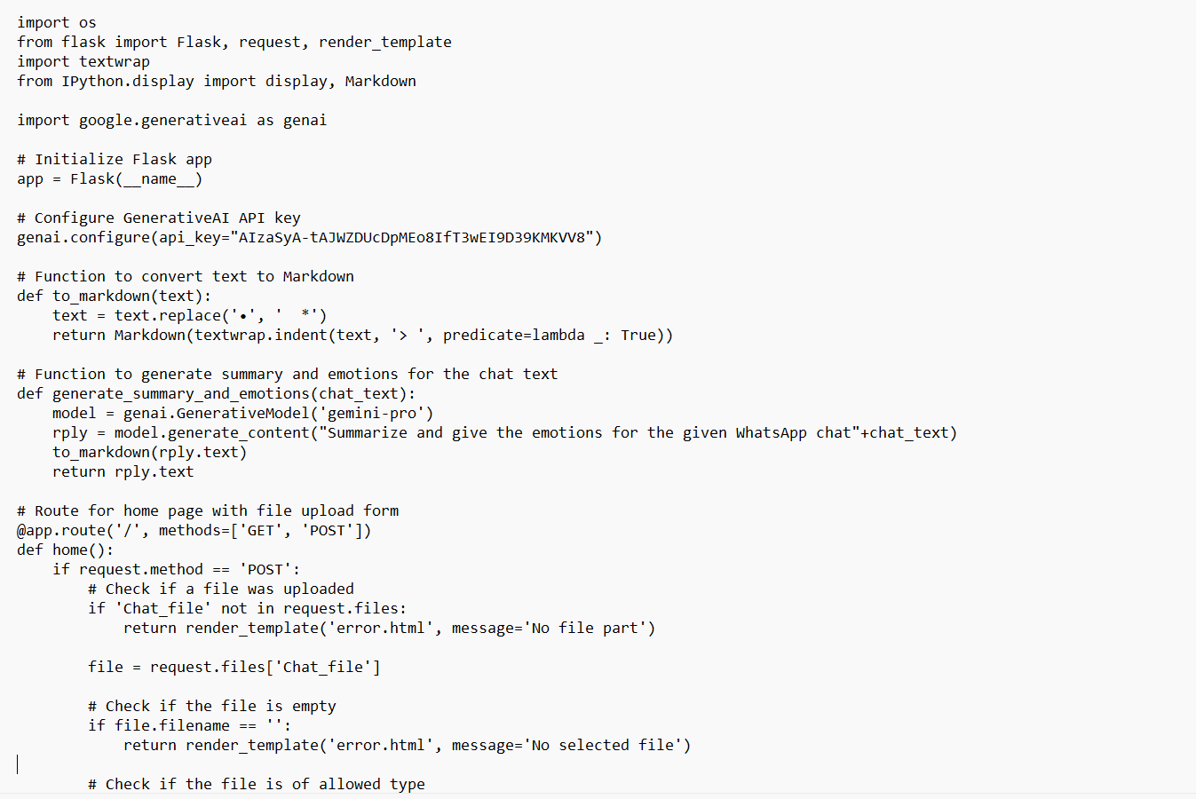
Source Code
Artificial Intelligence 03/11/2025

Slide 15
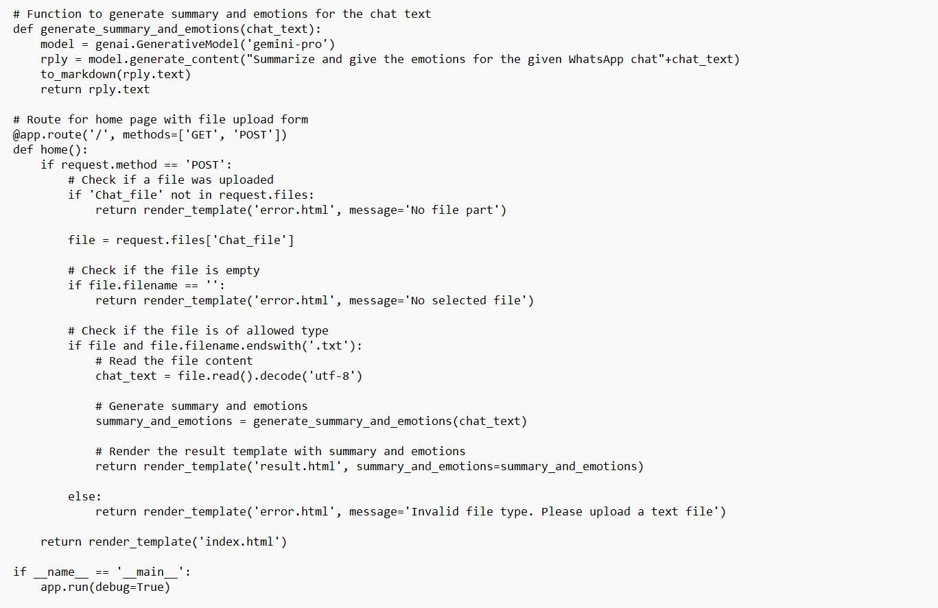
Artificial Intelligence 03/11/2025

Slide 16
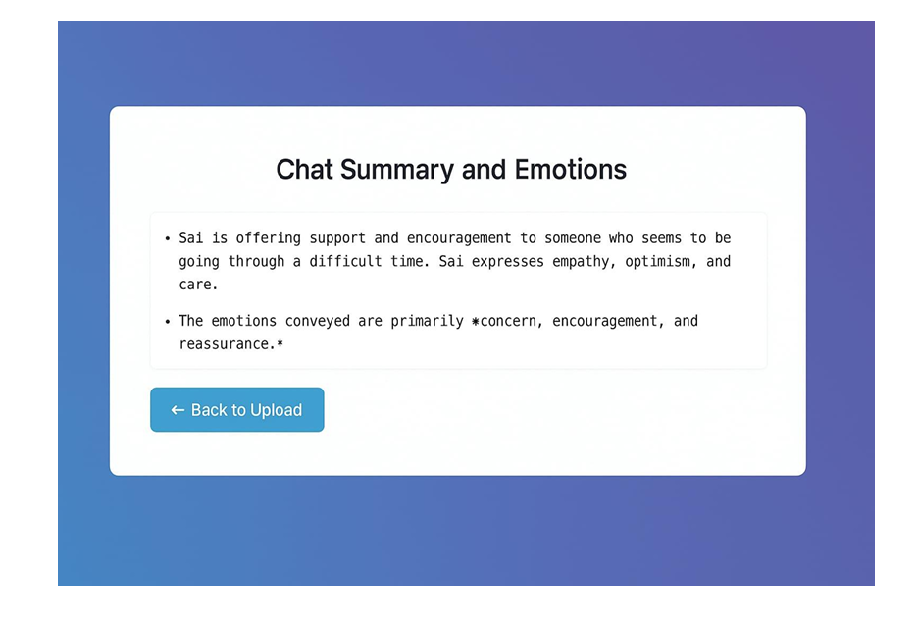
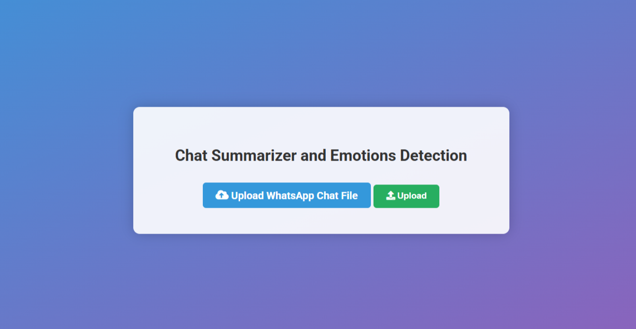
Output
Fig: Chat analyser and emotion detector
Artificial Intelligence 03/11/2025

Slide 17
TASK 2
Development of an image classification model for a custom dataset
Artificial Intelligence 03/11/2025

Slide 18
Abstract
Image classification is one of the most widely used applications of Artificial Intelligence and Computer Vision.
The aim of this task is to design and implement an image classification model for a custom dataset, where images belong to specific categories relevant to the chosen domain (e.g., medical images, plant diseases, traffic signs, or product categories).
The project involves dataset preprocessing, model training using Convolutional Neural Networks (CNNs) and transfer learning, evaluation using performance metrics, and deployment of a prototype system.
The outcome will demonstrate the practical use of AI in solving real-world problems through automated image recognition.
Artificial Intelligence 03/11/2025

Slide 19
Existing System
The existing system uses pre-trained Convolutional Neural Network (CNN) models for image classification.
Uses image classification models (like Google Vision API, standard datasets such as MNIST or CIFAR-10) which provides pre-trained solutions.
Designed for general-purpose classification tasks.
Artificial Intelligence 03/11/2025

Slide 20
Disadvantages
Limited accuracy on domain-specific/custom datasets.
Dependence on public datasets.
Many commercial APIs are costly.
Systems may fail in real world environments with noisy, low quality or imbalanced datasets.
Artificial Intelligence 03/11/2025

Slide 21
Proposed System
Takes input images from a custom dataset.
Preprocess images (resize, normalize, and augment them to improve training).
Train two models i.e A custom CNN model and transfer learning model (like ResNet, MobileNet). Evaluate the model using accuracy, precision, recall, and F1-score.
Deploys a web based demo application (using Streamlit/Flask) where users can upload an image and get classification results instantly. This way, the project is both educational and practically useful.
Artificial Intelligence 03/11/2025

Slide 22
Advantages
Saves time by automatically classifying images.
Reduces human mistakes compared to manual classification.
Can be applied to many areas: healthcare, farming, security, retail, etc.
Provides fast and real-time results.
Can be re-used and scaled for different datasets.
Artificial Intelligence 03/11/2025

Slide 23
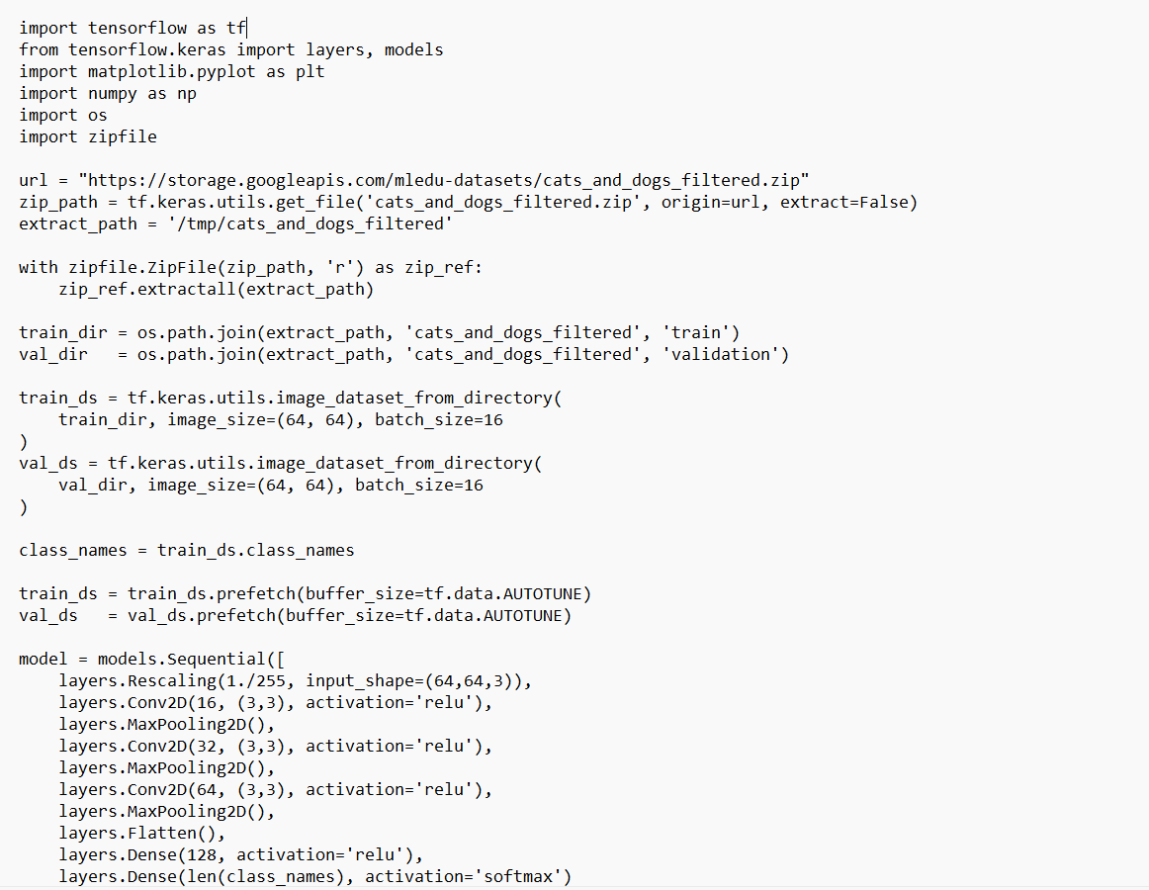
Source Code
Artificial Intelligence 03/11/2025

Slide 24
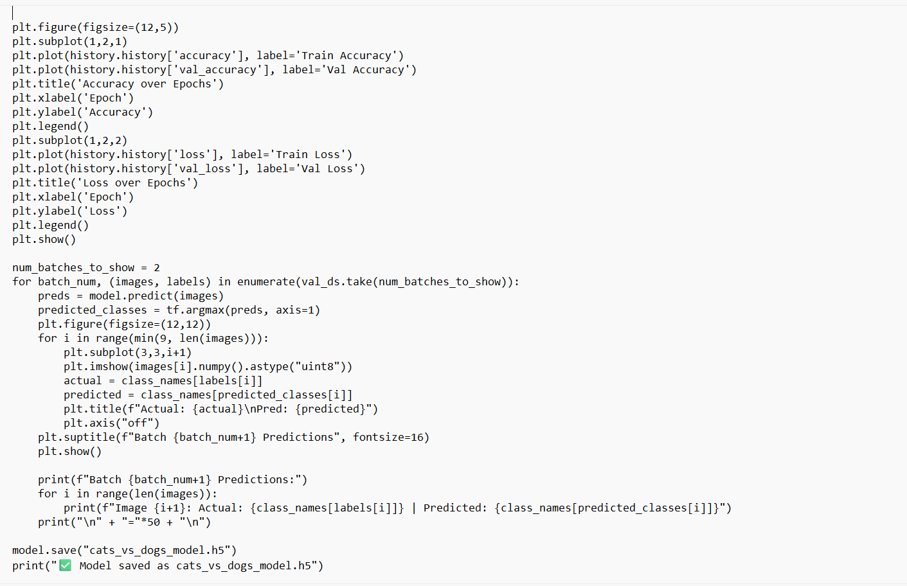
Artificial Intelligence 03/11/2025

Slide 25
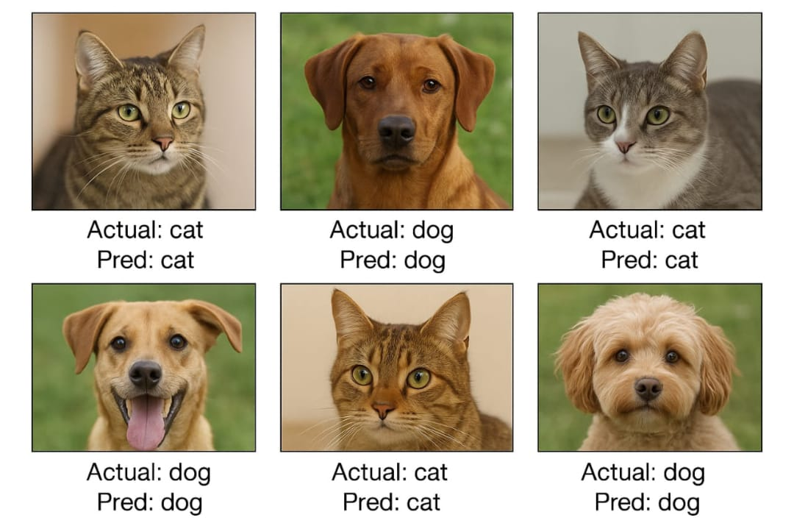
Output
Fig: Image classification model
Artificial Intelligence 03/11/2025

Slide 26
TASK 3
Spam Email Classifier
Artificial Intelligence 03/11/2025

Slide 27
Abstract
Email spam is one of the most common cybersecurity threats, causing inconvenience, security breaches, and data theft.
Traditional rule-based filters are ineffective against the evolving nature of spam.
This project proposes an AI-based spam email classifier that leverages Machine Learning (ML) and Natural Language Processing (NLP) to automatically identify and filter out spam messages.
By training the system on labeled datasets (spam vs. ham), the classifier learns textual and semantic patterns that distinguish spam from legitimate emails.
The aim is to build an efficient, accurate, and adaptive spam detection system that enhances user security and productivity.
Artificial Intelligence 03/11/2025

Slide 28
Existing System
The existing spam email classification system primarily uses rule-based filters that rely on predefined rules and keyword matching to detect spam messages.
Emails are filtered based on specific rules set by administrators to classify them as spam or non-spam.
It analyzes the subject line, email body, and sender address to identify suspicious content.
Artificial Intelligence 03/11/2025

Slide 29
Disadvantages
Limited accuracy on custom datasets.
Dependence on public datasets.
Less flexibility.
Many commercial APIs are costly.
Real world failure risk
Artificial Intelligence 03/11/2025

Slide 30
Proposed System
The model is based on naive bayes classifier
Works extremely well with text data
Cleans and processes raw email text by removing stopwords, punctuation, numbers, and special characters.
Converts email content into a standardized form suitable for analysis.
The model is trained on a labeled dataset containing spam and non-spam examples.
It learns to identify patterns and word distributions common in spam emails.
Artificial Intelligence 03/11/2025

Slide 31
Advantages
Reduces manual effort in filtering spam emails.
Improves inbox management and user productivity.
Adapts to changing spam trends through retraining.
Provides high accuracy using AI-based algorithms.
Artificial Intelligence 03/11/2025

Slide 32
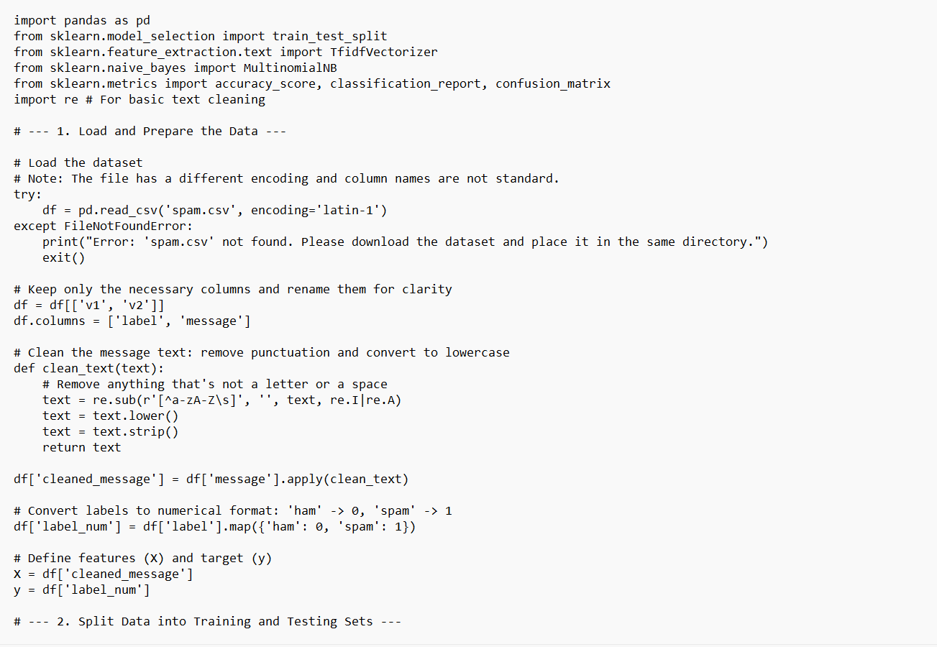
Source Code
Artificial Intelligence 03/11/2025

Slide 33
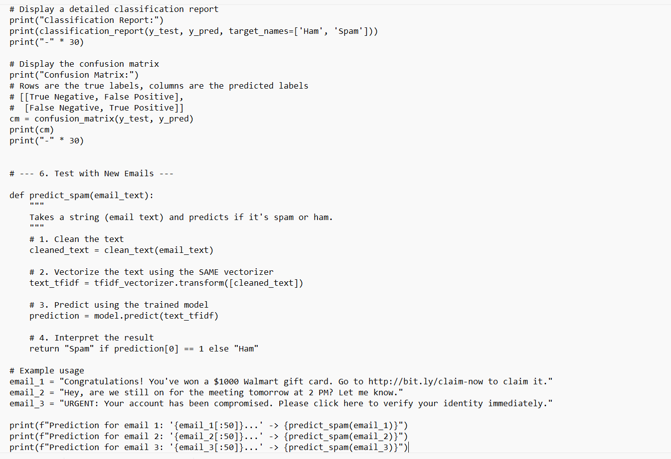
Artificial Intelligence 03/11/2025

Slide 34
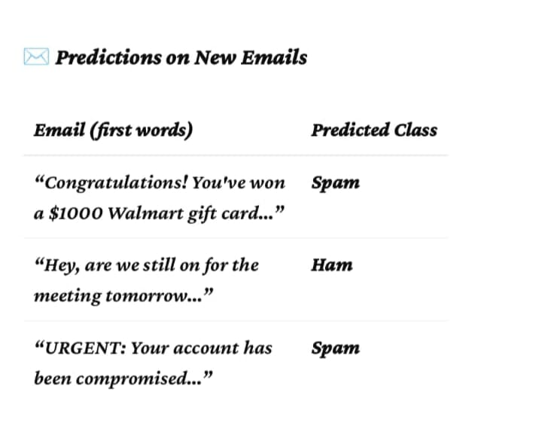
Output
Fig: Spam email classifier
Artificial Intelligence 03/11/2025

Slide 35
Conclusion
A foundational understanding of its core concepts, subfields, and applications is essential for anyone seeking to explore or work within this domain.
The AI domain encompasses algorithms that define problem-solving logic, models that represent knowledge and patterns, and modules that implement specialized functions within AI systems.
Artificial Intelligence 03/11/2025

Slide 36
Thank You
Artificial Intelligence 03/11/2025

